Slide 1
April
is
National Safe Digging Month

Slide 2


Before you Dig
Know What's Below
Call 811
Ketha Molina
Notes:
Welcome and Speaker Bio

Slide 3

What is 811?
Notes:
811 is the federally designated call before you dig number that helps homeowners and professionals avoid damaging these underground utilities. When you make the free call to 811 a few days before you dig, you’ll help prevent unintended consequences such as injury to you or your family, damage to your property, utility service outages to the entire neighborhood, and potential fines and repair costs.

Slide 4
About Texas811
Texas811 is the link between your plans to dig and our member utility companies.
Texas811 does not mark underground utilities
There is no cost for the onecall request.
Texas811 provides excavation education to excavators, emergency responders and the public
Notes:
Texas811 is the link between your plans to dig and our member utility companies.
Texas811 does not actually mark underground utilities. We notify utility companies of the planned excavation and they send locators to mark their lines.
All requests to locate underground utilities in the state of Texas originate with Texas811.
Texas811 members are utility companies and municipalities who choose Texas811 to provide them notifications of planned excavations near their underground lines. To educate excavators, emergency responders and the public, Texas811 hosts damage prevention educational events; an annual Summit, Safety Days, Excavator Workshops and training sessions.

Slide 5


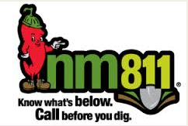

Know the state
“Call before you dig” laws
Notes:
Fact: Did you know that in 2017 there were 9,163 damages to underground oil and gas lines in Texas? According to the RRC of Texas over a quarter of those damages could have been avoided with a call to 811. (27%)

Slide 6

Call 811 Before You Dig - It’s the Law
Chapter 251-Underground Facility Damage Prevention Safety Act
RRC Chapter 18-Texas Administrative Code
Notes:
In Texas, there are 2 laws that affect excavation practices. Texas Utilities Code Title 5, Chapter 251 and RRC UPDPR Title 16, Chapter 18. Both laws reference that notifying your states One Call is mandatory at least 2 working days prior to excavation.

Slide 7
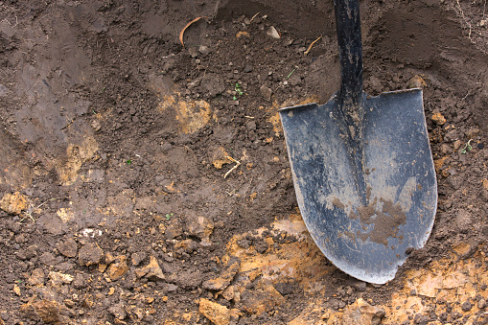
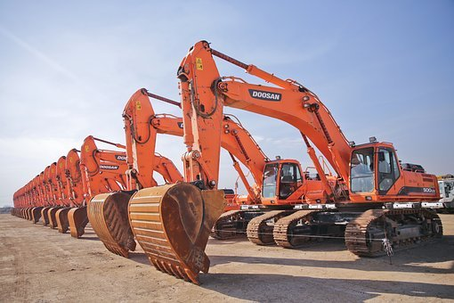
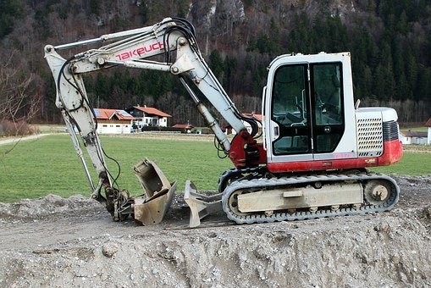
excavation: Defined by the law
Excavate: Movement of earth by any means
Excavator: A person that engages in or is preparing to engage in the movement of earth
Notes:
Think about this: How many of you are professional excavators? How many of you have excavation duties for your company? How many of you are property or land owners? Gardens? Tree planting?
These definitions are derived from Title 16, Chapter 18 (Underground Pipeline Damage Prevention Rule) which is one of 2 laws and 3 sources we will be referencing today.
The following information I’m going to share applies to anyone who intends to perform excavation.

Slide 8
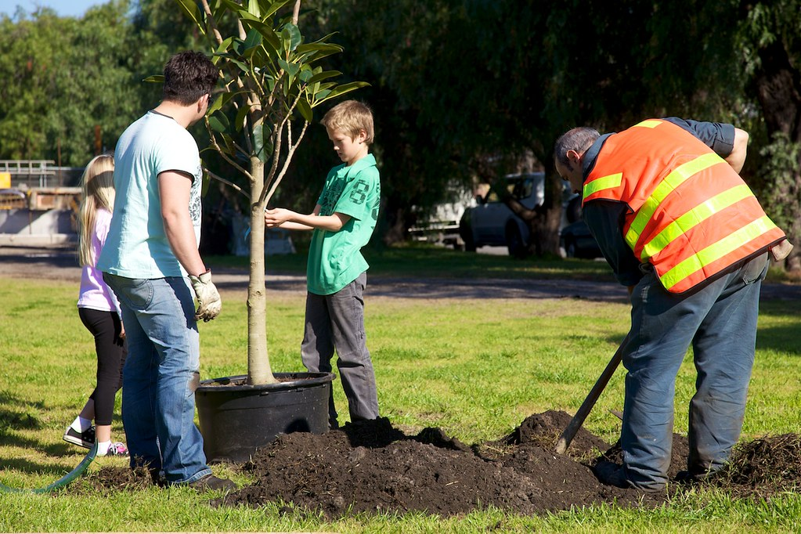
This Photo by Unknown Author is licensed under CC BY-NC-ND

Slide 9

Class A vs. Class B Facilities
Class A underground facility
An underground facility that is used to produce, store, convey, transmit, or distribute:
Electrical Energy
Natural or synthetic gas
Petroleum or petroleum products
Steam
Any form of telecommunications service, including voice, data, video, or optical transmission, or cable television service
Any other liquid, material, or product not defined as a Class B underground facility

Slide 10
Class A vs. Class B Facilities
Class B underground facility
An underground facility that is used to produce, store, convey, transmit, or distribute:
Water
WasteWater
Slurry
Class B underground facilities are not required by law to register their lines
If water or wastewater facilities are not on your ticket, It may be necessary to make a second call
Notes:
Discuss class A requirements vs. Class B voluntary membership
Review of time frames (2 Days excluding Sat/Sun/Holidays) (not more than14 days prior)
Discuss member response within 2 working days (Mention that all gas utilities are required to provide a positive response within that time frame)

Slide 11
Excavator Requirements to Notify 811- wait the time Required
Utilities Code
Title 5 Provisions affecting the operation of utility facilities
Ch. 251 Underground Facility Damage Prevention and Safety
Sec. 251.151 – Duty of an Excavator
(a) … a person who intends to excavate shall notify a notification center not earlier than the 14th day before the date the excavation is to begin or later than the 48th hour before the time the excavation is to begin, excluding Saturdays, Sundays and legal holidays.

Slide 12
Excavator Requirements to Notify 811
Texas Administrative Code: Title 16 Economic Regulation; Part 1 Railroad Commission of Texas; Chapter 18 – Underground Pipeline Damage Prevention
§ 18.3 - Excavator Notice to Notification Center
(a) An excavator shall request the location of underground pipelines at each
excavation site by giving notice to the notification center as required by Texas Utilities Code, Chapter 251.
(c) When an excavation site cannot be clearly identified and described on a line locate ticket, the excavator shall use white lining to mark the excavation area ...

Slide 13
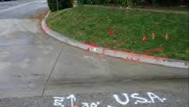
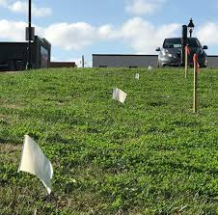
WHAT IS WHITE LINING?
White-lining is the first step to the 811 process and has been proven to reduce unnecessary damages
White-lining is the practice of marking your route of excavation with “white paint, flags, stakes, or a combination of these to outline the dig site prior to notifying the one call center and before the locator arrives on the job
Notes:
White-lining is the first step to the 811 process and has been proven to reduce unnecessary damages
White-lining is the term used to describe the process that excavators use to identify the parameters of their proposed excavation prior to requesting an underground facility locate via the 811 notification system.
White-lining is the practice of marking your route of excavation with “white paint, flags, stakes, or a combination of these to outline the dig site prior to notifying the one call center and before the locator arrives on the job

Slide 14
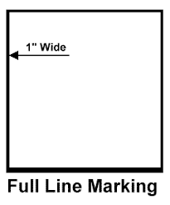
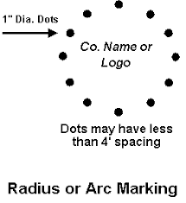
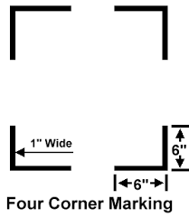
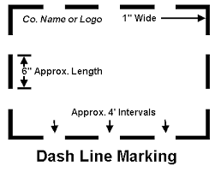
Examples of White LINING

Slide 15

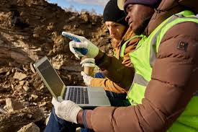
Call 811
Click
Notes:
There are a couple of ways to get your notice of excavation to your states 811 center. You can always call 811. We are open 24/7 7 days a week and have Spanish speaking DPA’s available at all hours…
The faster option is using the Texas811 portal. The average phone call takes 8 minutes. The website locate submission can be processed in half of that time. It gives you access to all of your locate requests submitted.
You can issue emergency’s and no-response tickets through the portal as well.
Free product… Free training

Slide 16
Locate Request Ticket Types
A Normal ticket requires a two working day notice, excluding weekends and holidays, before work can begin. (14-day ticket life)
An Update ticket extends the life of an existing ticket. (Day 10 or 12)
An Update/Remark gets the lines remarked. (Day 10 or 12)
A No Response ticket is processed when one or more underground utilities on your one call ticket has not responded.
Notes:
A Normal ticket requires a two working day notice, excluding weekends and holidays, before work can begin.
A Digup ticket is issued if you expose, cut or hit an underground utility while working. If you hit a gas pipeline, even if it is just a scratch, leave the area immediately. If product is released, once at a safe distance, please call 911, then Texas811. If you make contact with a utility line that is not a gas pipeline, please contact Texas811 immediately so we can notify the utility whose lines are affected. The utilities will come to the site to inspect the damage and make any repairs that may be necessary.
An Emergency ticket is used when the work being done is to repair a situation that is a danger to life, health or property or a situation in which the public need for uninterrupted service and immediate re-establishment of services are interrupted compels immediate action. Penalties may result if non-emergency situations are reported as an emergency.
An Update ticket extends the life of an existing ticket.
An Update/Remark gets the lines remarked. Both Update and Update Remark tickets can be requested during the automated recording when calling or through The Portal online.
A No Response ticket is used when one or more underground utilities on your one call ticket has not responded.
A Survey and Design ticket is use for projects where the excavator needs to know what utilities are in the area but no excavation will be taking place within the next 14 days. Excavation will, however, be taking place within the next 18 months.

Slide 17
Locate Request Ticket Types
An Emergency ticket is processed when the work being done is to repair a situation that is a danger to life, health or property.
A situation in which the public need for uninterrupted service and immediate re-establishment of services compel an immediate action.
A Digup ticket is processed anytime an excavator or homeowner has hit, nicked, cut, or exposed a line.
Notes:
A Normal ticket requires a two working day notice, excluding weekends and holidays, before work can begin.
A Digup ticket is issued if you expose, cut or hit an underground utility while working. If you hit a gas pipeline, even if it is just a scratch, leave the area immediately. If product is released, once at a safe distance, please call 911, then Texas811. If you make contact with a utility line that is not a gas pipeline, please contact Texas811 immediately so we can notify the utility whose lines are affected. The utilities will come to the site to inspect the damage and make any repairs that may be necessary.
An Emergency ticket is used when the work being done is to repair a situation that is a danger to life, health or property or a situation in which the public need for uninterrupted service and immediate re-establishment of services are interrupted compels immediate action. Penalties may result if non-emergency situations are reported as an emergency.
An Update ticket extends the life of an existing ticket.
An Update/Remark gets the lines remarked. Both Update and Update Remark tickets can be requested during the automated recording when calling or through The Portal online.
A No Response ticket is used when one or more underground utilities on your one call ticket has not responded.
A Survey and Design ticket is use for projects where the excavator needs to know what utilities are in the area but no excavation will be taking place within the next 14 days. Excavation will, however, be taking place within the next 18 months.

Slide 18
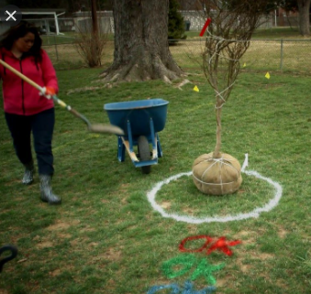
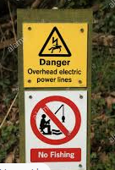
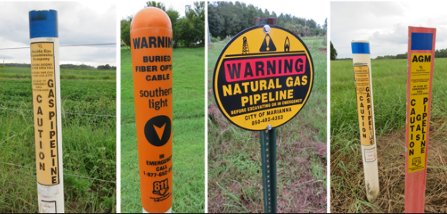
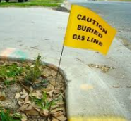
Respect
marks - flags -signage
Pipeline Markers indicate the
presence of a pipeline.
Company Name
Company Phone Number
Product transmitted in the line

Slide 19
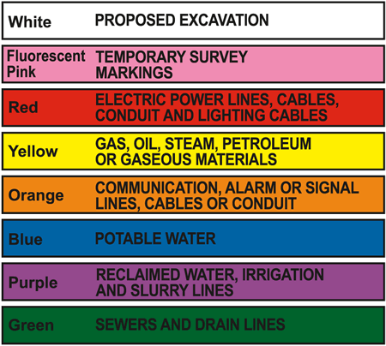

Notes:
Once notified, everything should be marked in accordance with the APWA color code.
Depending on audience, discuss code

Slide 20
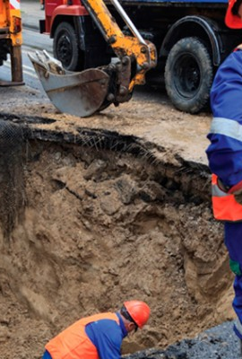
Damage Prevention
Notes:
A Normal ticket requires a two working day notice, excluding weekends and holidays, before work can begin.
A Digup ticket is issued if you expose, cut or hit an underground utility while working. If you hit a gas pipeline, even if it is just a scratch, leave the area immediately. If product is released, once at a safe distance, please call 911, then Texas811. If you make contact with a utility line that is not a gas pipeline, please contact Texas811 immediately so we can notify the utility whose lines are affected. The utilities will come to the site to inspect the damage and make any repairs that may be necessary.
An Emergency ticket is used when the work being done is to repair a situation that is a danger to life, health or property or a situation in which the public need for uninterrupted service and immediate re-establishment of services are interrupted compels immediate action. Penalties may result if non-emergency situations are reported as an emergency.
An Update ticket extends the life of an existing ticket.
An Update/Remark gets the lines remarked. Both Update and Update Remark tickets can be requested during the automated recording when calling or through The Portal online.
A No Response ticket is used when one or more underground utilities on your one call ticket has not responded.
A Survey and Design ticket is use for projects where the excavator needs to know what utilities are in the area but no excavation will be taking place within the next 14 days. Excavation will, however, be taking place within the next 18 months.

Slide 21
Pre-Excavation Checklist
Complete a pre-excavation walk-out of the entire job site. Your objective is to visually inspect the dig area to ensure all utilities are marked. Look for signs of utilities that may not be marked such as, above-ground pedestals, gas meters, man-hole covers, drains, or utility poles with cable risers. If you find these indicators and suspect that there is an unmarked utility DO NOT PROCEED. Notify One Call that an unidentified line has been discovered. When you have completed your walk-out, complete the following check list:
Crew Foreman One-Call Ticket #___________ Contact #___________ Date________
Verify that the One-Call ticket covers the ‘Scope of work’ and ‘Work to begin’ date:
  I have verified the One-Call ticket covers the ‘Scope of work’
  I have verified the One-Call ticket ‘Work to begin’ date
What marked utilities did you observe?
Gas (Yellow) Electric (Red) Telephone (Orange) Cable TV (Orange) Water (Blue) Sewer (Green)
Based on visual observation, did you see signs of any unmarked utilities? Yes No
If Yes, please identify?
Gas (Yellow) Electric (Red) Telephone (Orange) Cable TV (Orange) Water (Blue) Sewer (Green)
  I have notified One Call of the unmarked Utility
Photograph the entire proposed work area including all locate marks.
  I have photographed the entire site prior to excavation
  I have photographed existing locate/markings
Advise your crew members of the following: If they have to cross a marked Utility they must HAND DIG ONLY within 18” of the locate marks plus half the diameter of the buried facility.
RESPECT THE MARKS!
  I have advised my crew of the 18” hand dig rule
PRE EXCAVATION CHECK- LIST
Notes:
Discuss pre excavation worksite documentation and damage documentation
No such thing as too many
Incorporate landmarks
Take several angels close and at a distance

Slide 22
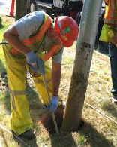
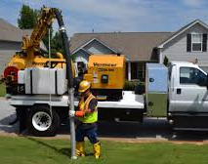
Potholing or Daylighting
is the process of digging a test hole to locate expose underground facilities.
Determines lines positions - horizontal and vertical orientations
Daylighting / Potholing Prior to Excavation
Notes:
Potholing is the practice of digging a test hole to expose underground utilities to ascertain the horizontal and vertical location of the facility. The horizontal and vertical position of the exposed facility must be tied to a survey benchmark or permanent above grade feature. The position may be identified by GPS or traditional survey coordinates or by measuring the distance, with a tape measure, to permanent features in three horizontal directions. In addition, the vertical distance below grade should be obtained.
Potholing is utilized to prevent excavation damage to underground utilities. Excavate soil with high-speed suction straight down until the utility line is partially uncovered. Both air and hydro vacuum excavation can be used for potholing. These methods utilize pressurized water or air to quickly move ground contents out of the way.
When potholing, utility crews use a portable vacuum excavator. First, test holes, usually measuring 6 to 12 inches deep, are made along the line where they plan to dig or begin construction. They excavate soil with high-speed suction straight down until the utility line is partially uncovered.
Both air and hydro vacuum excavation can be used for potholing. These methods utilize pressurized water or air to quickly move ground contents out of the way. This allows operators to have a clear view of subsurface features.
Hydro and air vacuum excavation safely dig even through hard, compacted dirt, rocky soil, and clay. Unlike the traditional methods of using a shovel or heavy equipment, it won’t cut a utility line hidden below the surface. Vacuum excavation is a non-invasive, non-mechanical, and non-destructive process. Potholing with vacuum excavation simply uncovers the line, leaving it intact, without damaging or moving it. Plus, when compared to these other methods, vacuum excavation leaves a smaller site footprint and decreases the time needed to finish the job.
Then, displaced dirt and rock debris is suctioned away from the excavation area through a large hose. It is stored in a holding tank on the truck. Excavator trucks with different capacity tanks can be used to fit the size of the job. Once the lines have been accurately located, accumulated wet or dry soil which was removed during the digging process can be replaced as backfill.

Slide 23
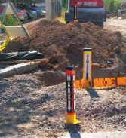
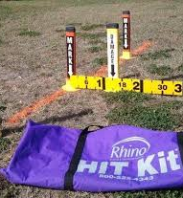
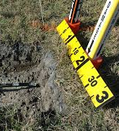
Pre-Excavation photos of the dig site
Photos as work progresses

Slide 24
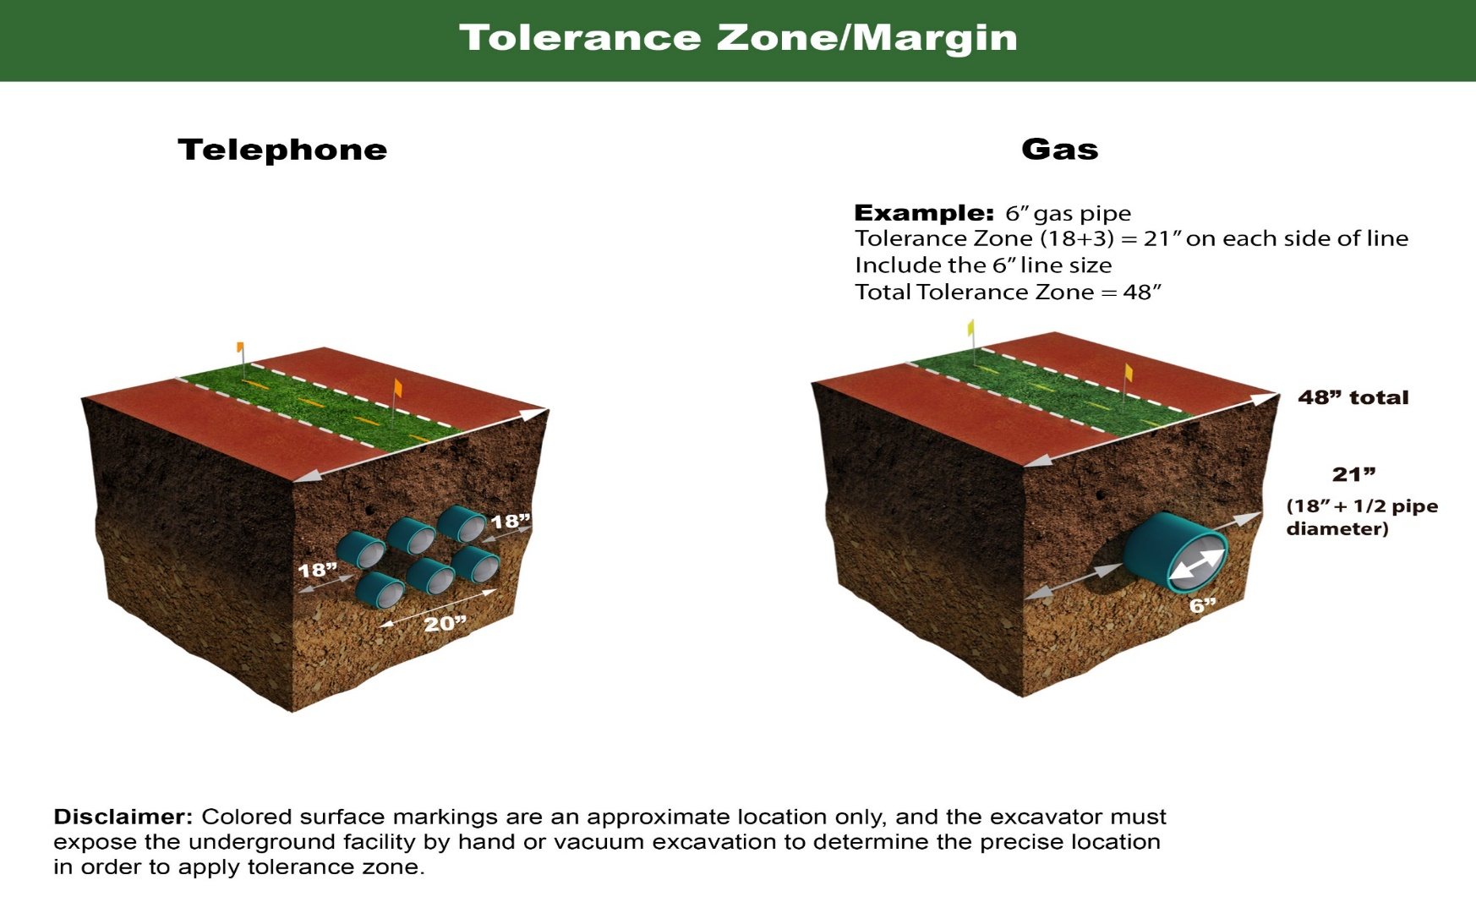
The Tolerance Zone is half the nominal diameter of the underground pipeline plus a minimum of 18” on either side of the outside edge of the pipeline on a horizontal plane.
Tolerance Zone
No Mechanized Equipment within 18” of the pipe Chapter 18.2 (21)

Slide 25
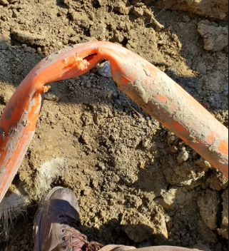
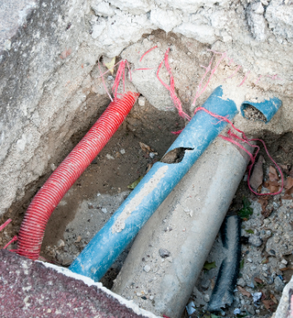
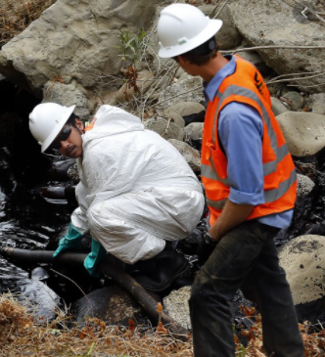
Report all Damage

Slide 26
Damage includes but is not limited to:
Defacing, scraping, displacement, penetration, destruction, or partial or complete severance of an underground line - or of any protective coating, housing, or other protective device of an underground utility/facility;
Weakening of structural or lateral support of an underground pipeline that affects the integrity of the line; or failure to properly replace the backfill surrounding an underground line.
What constitutes a damage

Slide 27
What to Do if You Hit a Line
Stop work immediately.
Call 811 to Report the Damage
Do not attempt to repair any utility line yourself.
Do not backfill the location of the damaged line.
If you hit a gas line and gas is leaking or spewing…

Slide 28
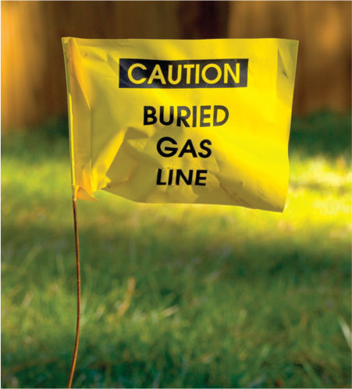
Product release safety
Do This:
Abandon Equipment
Stay Upwind
Keep Others Away from Area
Eliminate Potential Ignition Sources
Call 911
Within ONE Hour Contact 811 to Submit a DigUp
Notes:
In the event of a gas line strike and release of product, exit the equipment and leave it running and get to a safe distance. DO NOT TURN IT OFF (possible Ignition Source)
Stay upwind of any release of product (Some products can be deadly)

Slide 29
Damages Specific to Oil & Gas - Chapter 18 reporting requirements
Changes to RRC Chapter 18
Call 911 (Only If Release of Product)
Call 811 within ONE hour to Submit DigUp Ticket
File TDRF Report with 30 Days
Notes:
In the event of a gas line strike, there are some requirements that need to be met in order to stay in compliance with Texas State Laws.
If damage to a pipeline from excavation activity causes the release of any flammable, toxic, or corrosive gas, hazardous liquid, or carbon dioxide from the pipeline, the excavator shall promptly report the release to appropriate emergency response authorities by calling 911
Report the line strike to 811 within 2 hours of the event
Each excavator that damages an underground pipeline shall notify the operator of the damage through the notification center at the earliest practical moment but not later than one hour following the damage incident. The excavator shall also submit report of the damage incident to the Commission using TDRF, which may be accessed through the Commission's online reporting system and the excavator sign-in, within 30 days of the incident.

Slide 30
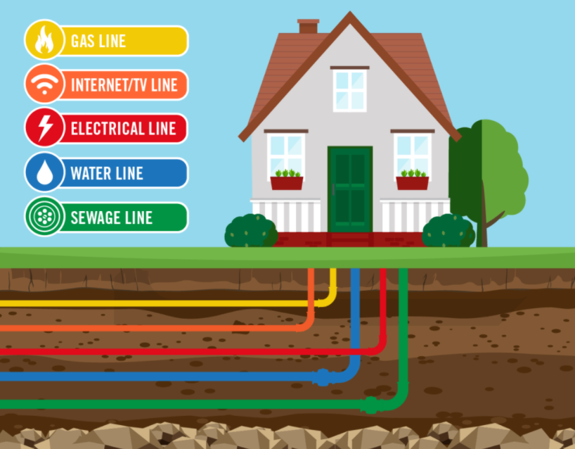

Slide 31
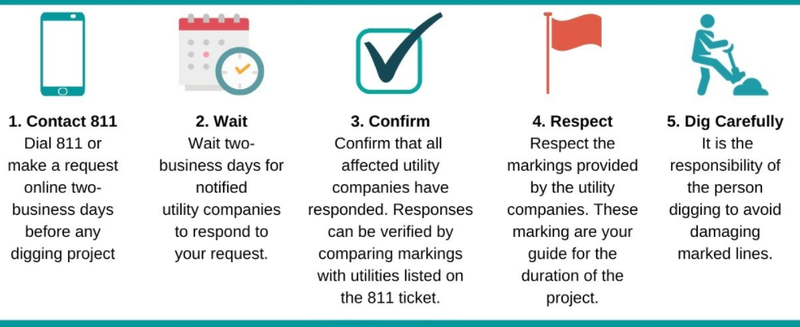

Slide 32
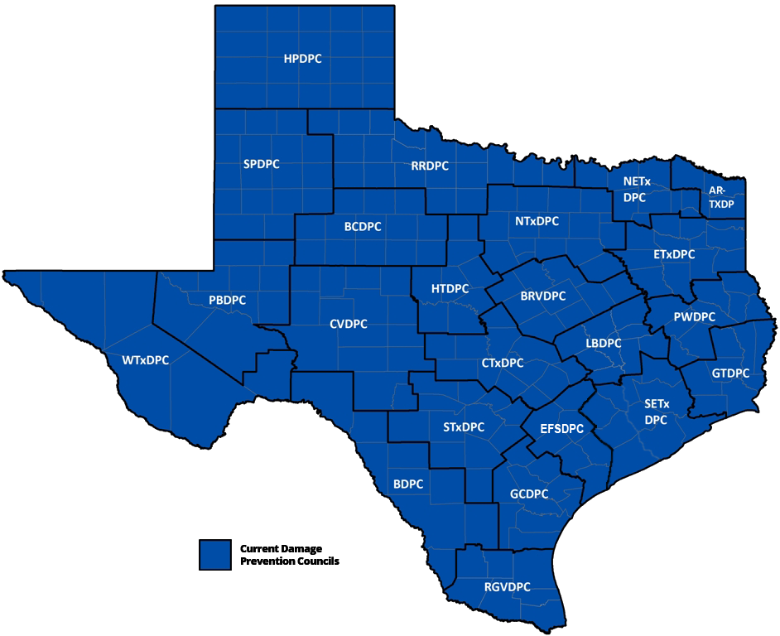

Damage Prevention Councils
www.DPCofTexas.org
Notes:
We are a non-profit association dedicated to the prevention of damage to underground facilities, public safety and environmental protection through stakeholder education and communication. We promote damage prevention and safe digging practices for underground facilities across the State of Texas
Promote DPC facebook page

Slide 33

www.DPCofTexas.org
Events
Tools
Resources
Calendars
Board of Directors
Committees
Fundraising
Sponsorships

Slide 34


Ketha Molina SMS ASP CSHO CST
Sr. Damage Prevention Manager
Panhandle – Permian Basin – Abilene – Wichita Falls
Cell: 432-209-9482
Email: KethaMolina@Texas811.org
Notes:
Contact info slide

