Slide 1


The
Lifeline
Seatbelt Safety for Commercial Drivers

Slide 2




The Numbers Don't Lie — Texas on the Road
Texas leads the nation in commercial truck crashes.
Every statistic here represents a real life — many of which could have been saved.
1 in 7
40%
CMV crashes in the U.S. occur in Texas
of CMV fatally injured drivers were unbelted
More than any other state — by a wide margin
A preventable cause in nearly half of all fatal CMV crashes
#1
3×
Texas ranks first in the nation for CMV crash fatalities
Unbelted CMV drivers are 3× more likely to die in a crash
This is a distinction no state wants — and it demands action
The seatbelt is the single most proven life-saving intervention

Slide 3








|
CDL SAFETY TRAINING SERIES
TEXAS ROAD RISK ASSESSMENT
GROUND-LEVEL REALITY
What Texas Roads Look Like
for CMV Drivers
THE BOTTOM LINE
A seatbelt is the single most effective countermeasure in all of these scenarios.
Texas has more lane-miles of highway than any other state
More lane-miles means more exposure — and more opportunities for something to go wrong.
Urban corridors are among the deadliest freight routes in the nation
680K
Lane-miles of TX roadway
#1
State for CMV fatalities
I-10
I-35
I-45
— high-volume, high-hazard corridors through TX
Rear-end and rollover crashes are the top CMV crash types in TX
Every risk factor on this slide — weather, fatigue, rollovers, rear-ends — is made more survivable by one thing: buckling up.
Both crash types are survivable — with a seatbelt. Without one, they're frequently fatal.
Weather, fatigue, and distracted driving compound rollover risk
Texas weather events — fog, ice, flooding — strike without warning on freight corridors.
TEXAS — BIGGEST EXPOSURE, BIGGEST RISK

Slide 4



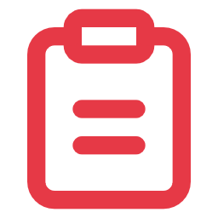
FMCSA COMPLIANCE
IT IS NOT OPTIONAL. IT IS A FEDERAL MANDATE.
Federal Law Requires It — FMCSA 392.16
CARD 1
CARD 2
The Rule
The Fine
49 CFR 392.16 requires all CMV drivers and passengers to wear a seatbelt whenever the vehicle is in motion — no exceptions, no exemptions.
Drivers face civil penalties of up to $2,750 per violation. Carriers can be penalized up to $11,000 per offense — fines that compound fast across a fleet.
1
2
CARD 3
CARD 4
The Record
The Career Impact
Seatbelt violations appear on your PSP (Pre-Employment Screening Program) record and impact your CSA scores — visible to every prospective carrier who checks your history.
Repeated violations can affect hiring decisions, insurance rates, and carrier safety ratings. A pattern of non-compliance signals risk — and follows you across the industry.
3
4
Source: FMCSA 49 CFR Part 392.16 · FMCSA Civil Penalty Guidelines
CDL Safety Training Series

Slide 5


FMCSA COMPLIANCE — CSA SCORE IMPACT
Your CSA Score: Belted vs. Unbelted Driver Record
COMPLIANT DRIVER
LOW RISK
NON-COMPLIANT DRIVER
HIGH RISK
Clean seatbelt record — zero violations on PSP
Seatbelt violations on PSP record for 3 years
No HOS/safety violations stacking on BASIC scores
Increases carrier's BASIC score under Driver Fitness category
Stronger hire-ability profile at safety-conscious carriers
VS
Triggers heightened roadside inspection scrutiny
Lower carrier liability exposure and legal risk
Jeopardizes employment at safety-conscious carriers
Carrier qualifies for better insurance premiums
One violation can cascade into broader carrier audit risk
DRIVER BASIC SCORE (UNSAFE DRIVING)
DRIVER BASIC SCORE (UNSAFE DRIVING)
Low — Below Alert Threshold ✓
Elevated — Alert Threshold Breached ✗
PSP records follow a driver for 3 years — one seatbelt violation can cost you your next job opportunity. Source: FMCSA CSA BASIC methodology.

Slide 6


MYTH-BUSTING
LET'S ADDRESS THE EXCUSES
"
"I've driven a million miles without a seatbelt.I'll be fine."
Every crash that ends a life was preceded by someone who thought exactly that.
The next three slides address the five most common myths CDL drivers believe about seatbelts.

Slide 7
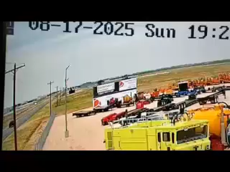
MYTH-BUSTING
LET'S ADDRESS THE EXCUSES
"

Slide 8









Myth vs. Reality
Five dangerous beliefs CDL drivers carry — and the facts that counter them.
CDL SAFETY · MYTH-BUSTING
THE MYTH
THE TRUTH
1
"I'll be thrown clear in a crash"
Being ejected is almost always fatal. Staying in the cab is survival.
2
"A big truck protects me — I don't need a belt"
Cab intrusion, rollovers, and secondary collisions all kill unbelted drivers.
3
"The belt will trap me if the truck catches fire or sinks"
Fire & submersion = <0.1% of CMV deaths. Ejection accounts for thousands.
4
"Short trips don't need a seatbelt"
Most fatal crashes happen within 25 miles of the driver's origin.
5
"I can brace myself"
At 30 mph, impact = 30× your body weight. No human can brace against that.
CDL Safety Training Series · Myth-Busting

Slide 9




CDL SAFETY TRAINING — PHYSICS OF A CRASH
What Really Happens in a Crash: The Three Collisions
Every crash is actually three separate collisions happening in rapid sequence. Understanding them changes everything.
STEP 1
STEP 2
STEP 3
COLLISION 1 THE VEHICLE COLLISION
COLLISION 2 THE HUMAN COLLISION
COLLISION 3 THE INTERNAL COLLISION
The truck strikes an object. Metal crumples. The vehicle decelerates with violent, sudden force — from highway speed to zero in a fraction of a second.
An unbelted body keeps moving at crash speed. You strike the steering wheel, dashboard, or windshield with lethal force — a fraction of a second after the vehicle stops.
Your internal organs collide with your ribcage and skull. Brain trauma. Aortic rupture. Liver laceration. These injuries kill — even when the cab remains intact.
3
A seatbelt prevents Collisions 2 and 3 — the only thing standing between you and lethal force is that buckle.

Slide 10
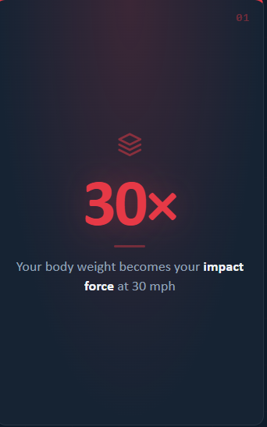
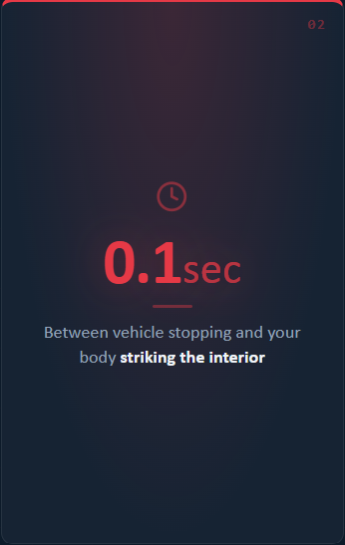
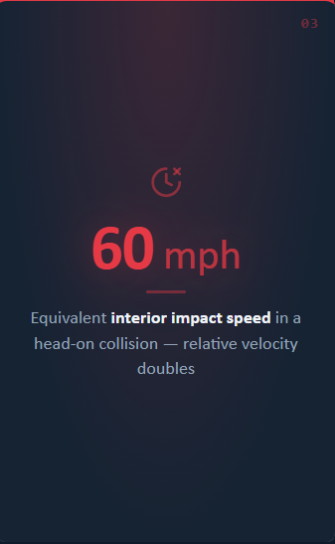
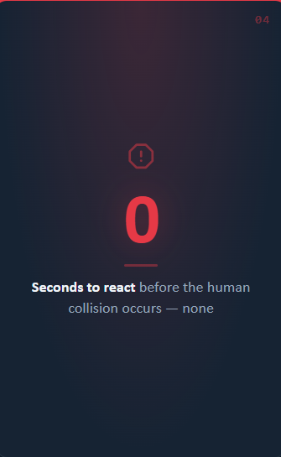




THE THREE COLLISIONS — PHYSICS BREAKDOWN
The Physics of a 30 mph Crash — Unbelted
01
02
03
04
30×
0.1sec
60 mph
0
Between vehicle stopping and your body striking the interior
Equivalent interior impact speed in a head-on collision — relative velocity doubles
Your body weight becomes your impact force at 30 mph
Seconds to react before the human collision occurs — none
The seatbelt is the only thing that intervenes between Collision 1 and Collision 2. Without it, physics takes over — and physics always wins.

Slide 11




CDL SAFETY TRAINING SERIES
The Three-Second Habit That Saves Lives
Before you shift into Drive — every single time.
1
2
3
REACH
CLICK
ROLL
Reach across your body and grab the seatbelt. Every single departure, no exceptions. Make it muscle memory — the same way you check your mirrors.
Pull the belt across your chest and lap, then click it into the buckle. Give it a firm tug — confirm it's snug and properly routed before you touch the shifter.
Now put the truck in gear. Not before. Every load. Every shift. Every time. The belt clicks first — then the wheels roll.
Three seconds. That's the gap between going home and not going home.
CDL SEATBELT SAFETY

Slide 12
CDL SAFETY TRAINING SERIES
FMCSA 392.16 COMPLIANT
YOU ARE THE LOAD WORTH PROTECTING
You haul loads worth hundreds of thousands of dollars.
You're bonded, licensed, trained, and trusted.
Don't forget to protect the most valuable cargo on that truck — YOU.
"Buckle up — because your family is waiting at the end of every run."
FMCSA 392.16 — seatbelt use is federal law
The three collisions happen in under one second
The three-second habit costs you nothing and could save everything
DRIVE SAFE · DRIVE SMART · DRIVE HOME
CDL SAFETY TRAINING

